Slide 1


Front end
(Introduction to css)
Lecture-15

Slide 2

Today’s Agenda
Handling Link In CSS
Pseudo-Classes
Making Links Look Like Button

Slide 3
Handling Links In CSS
Links or hyperlinks are an essential part of a website as they provide navigation through the site.
Therefore styling the links properly is an important aspect of building a user-friendly website.

Slide 4
Example
Example:
a
{
color: red;
}
This will style all aspects of the link (hover, visited, and active).
To style each part separately, we use pseudoclasses

Slide 5
The Link PseudoClasses
A link has four different states :
link
visited
hover and
active
These four states of a link can be styled differently using the following anchor pseudo-class selectors:
a:link
a:visited
a:hover
a:active

Slide 6
The Link PseudoClasses
a:link — define styles for normal or unvisited links.
a:visited — define styles for links that the user has already visited.
a:hover — define styles for a link when the user places the mouse pointer over it.
a:active — define styles for links when they are being clicked.

Slide 7
Example
a:link { /* unvisited link */
color: #ff0000;
text-decoration: none;
}
a:visited { /* visited link */
color: #ff00ff;
}
a:hover { /* mouse over link */
color: #00ff00;
}
a:active { /* active link */
color: #00ffff;
}

Slide 8
Making Link Look Like Button
We can also make our ordinary text links look like button using CSS.
To do this we need to utilize 3 more CSS properties which are
background-color
border
padding

Slide 9
Example
a:link,
a:visited {
color: white;
background-color: #1ebba3;
padding: 5px 20px;
border: 2px solid #099983;
text-decoration: none;
text-align: center;
font-size: 22px;
font-family: "Tangerine", cursive;
}

Slide 10
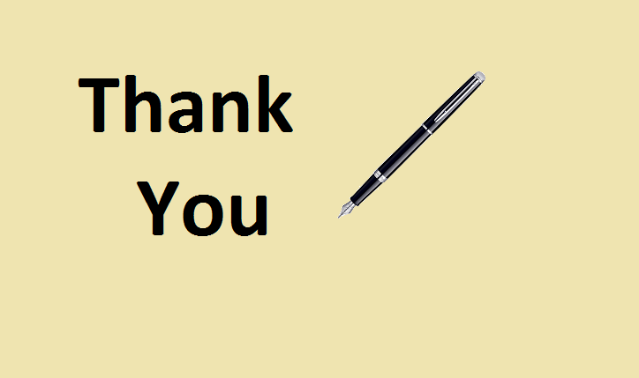
End Of Lecture
For any queries mail us @: scalive4u@gmail.com
Call us @ : 0755-4271659, 9826686245
Agenda for Next Lecture:
Styling Lists In CSS

